Slide 1
PFMS
Concept Summary
Over a period collection of loosely-coupled services evolve in the name of microservice which is a variant of the service-oriented architecture, in a medium to large organisation, hundreds and thousands of microservices get but and bring the next level of challenge to building the same microservices again and again or fails to reuse the existing services optimally. Thus wasting time, cost and agility to bring customer needs quickly to the market. Process flow microservices aim to solve this problem by giving the right exposure to the available services, using them and through a process flow framework reuse the already build services.
Problem Context
Reusability can be increased using a process flow approach of choosing the microservices
Maintainability is much easier to pick and choose the services of the right feature and decision making of what information can be re-used and what is the domain or business-specific details.

Slide 2
PFMS Solution Details
Layered process levels
Domain / Business unit grouped services build
With demarcation of local and global usage fields and parameter
Simple or complex service assessment
Validation at process level flows
Ability to pick the selected flow and service usage for

Slide 3
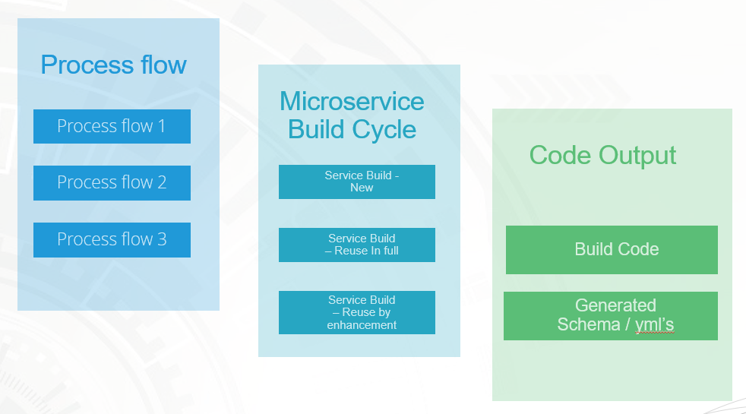
PFMS High-Level Function Block
1

Slide 4
PFMS IN DALL BANKING
Zac – Developer ( unknown department
Internet - Level 1
Customer details – Level 2
Type1 – Level 3
Type 2
Apply credit/- Level 2
Home Loan
Credit Cards – Level 1
Travel
Type of credit card offers Cards
Rewards
Corporate – Level 1
Pick1
Pick2
1

Slide 5
PFMS DALL BANKING
Zac – Developer ( unknown department
The process flow-driven selection provided the ability to choose the right feature or capability for the business unit to leverage the microservice
Provides the capability for the developer of the product owner to choose the service that can either be reused as-is or could be further enhanced
It also brings efficiency and a rapid build cycle by generating the required microservice and its components that could be leveraged with a lesser build cycle.
1

Slide 6
PFMS DALL BANKING
At this stage in the PFMS cycle we have the ability to choose the service and mark then as new or reuse then or get some enhancements into the service
1

Slide 7
PFMS DALL BANKING
Code output provisions the export of built code and its associated components
1

Slide 8
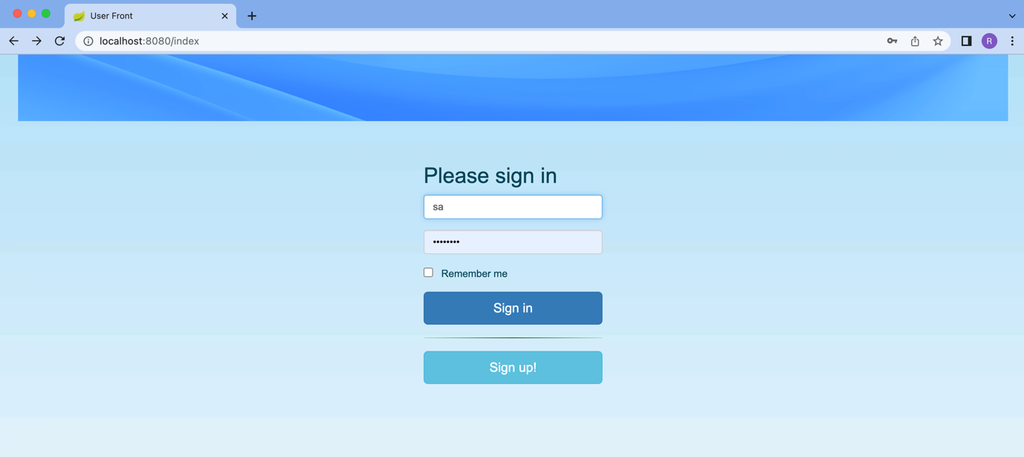
PFMS DALL BANKING – Application Demo
Main Login Screen of the PFMS Tool / Application

Slide 9
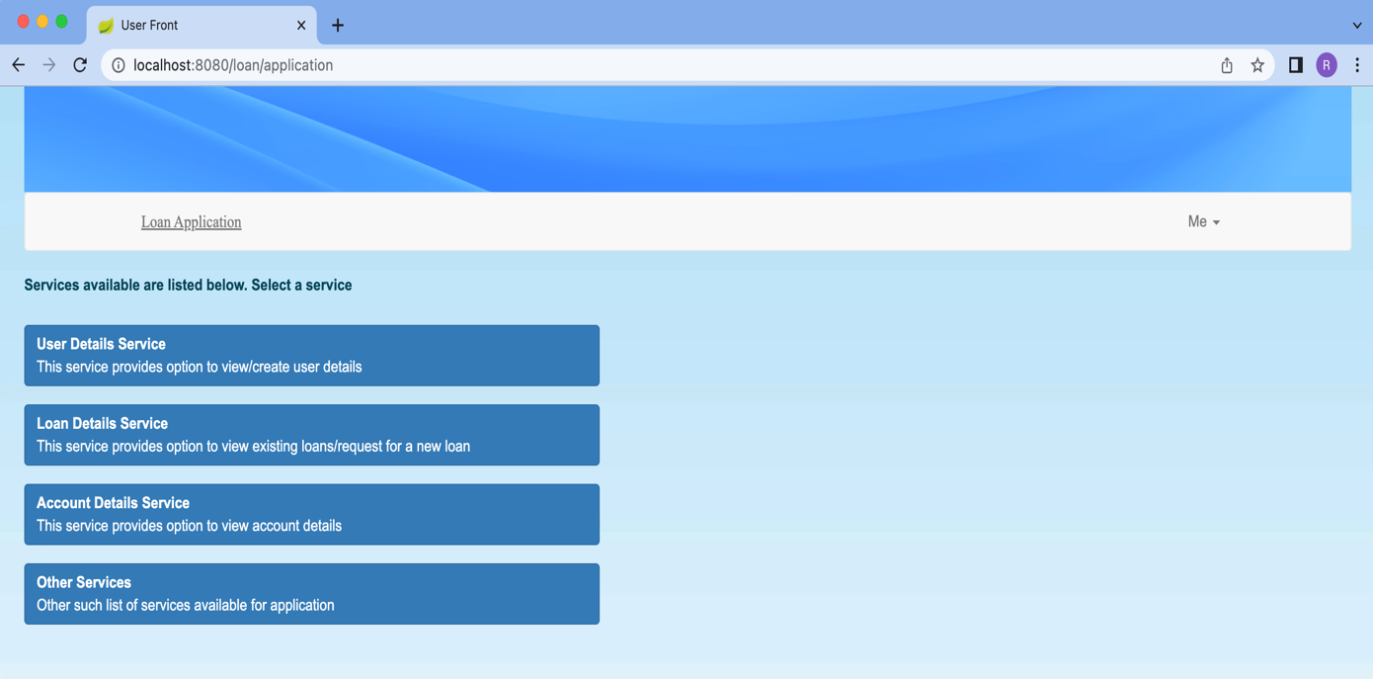
PFMS DALL BANKING – Application Demo
Service View of the process flow Module

Slide 10
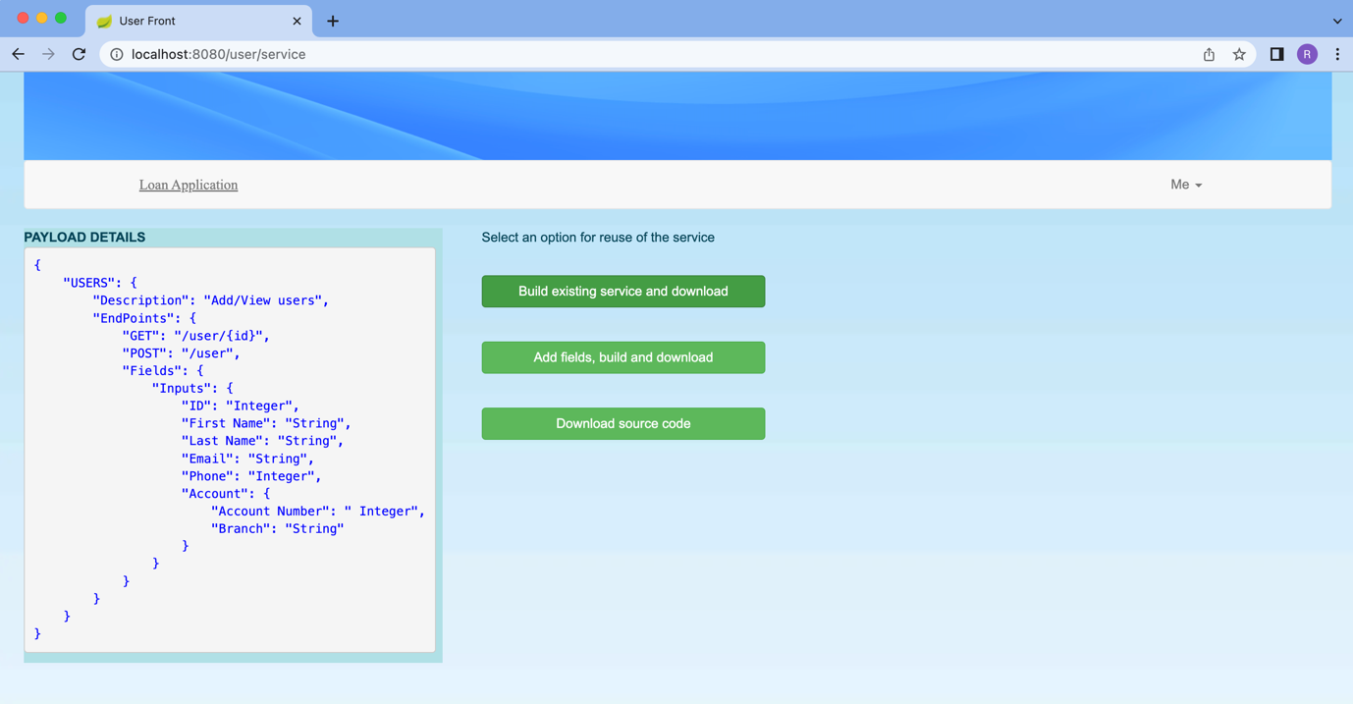
PFMS DALL BANKING – Application Demo
Build selection options view of the Build module section - 1

Slide 11
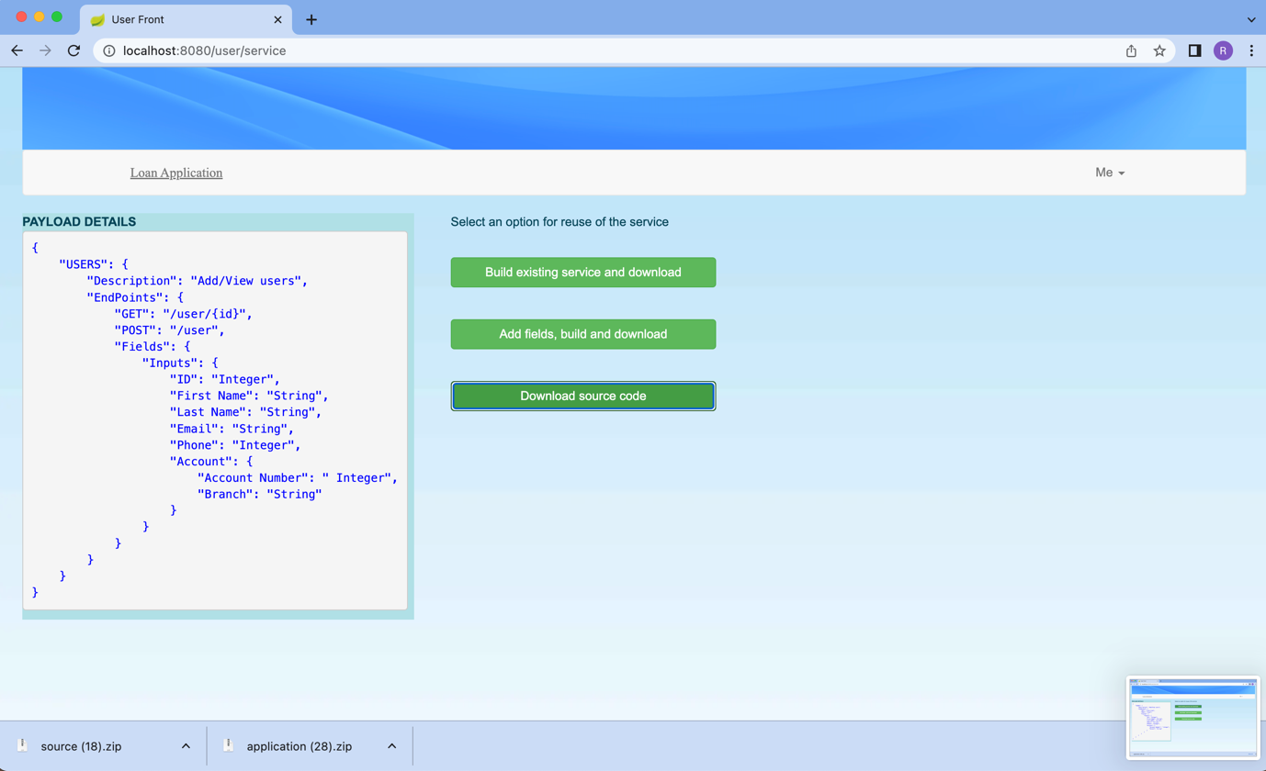
PFMS DALL BANKING – Application Demo
Build selection options view of the Build module section - 2

Slide 12
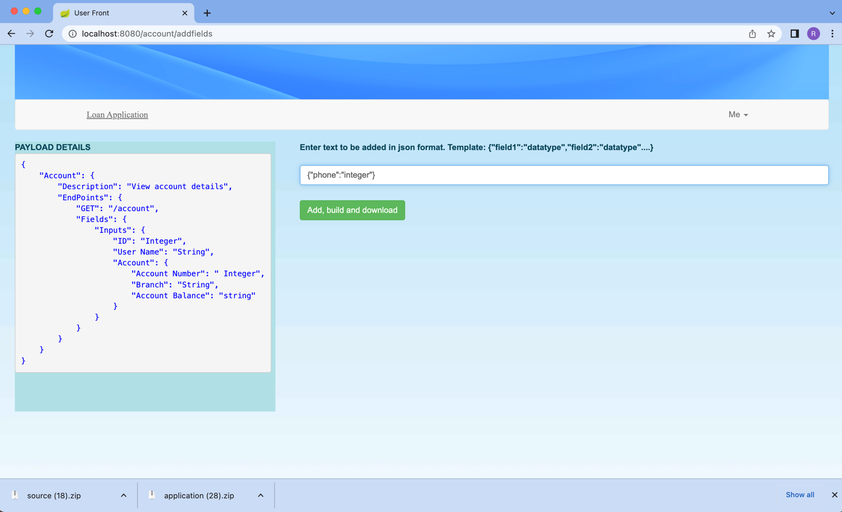
PFMS DALL BANKING – Application Demo
Build selection options view of the Build module section - 3

Slide 13
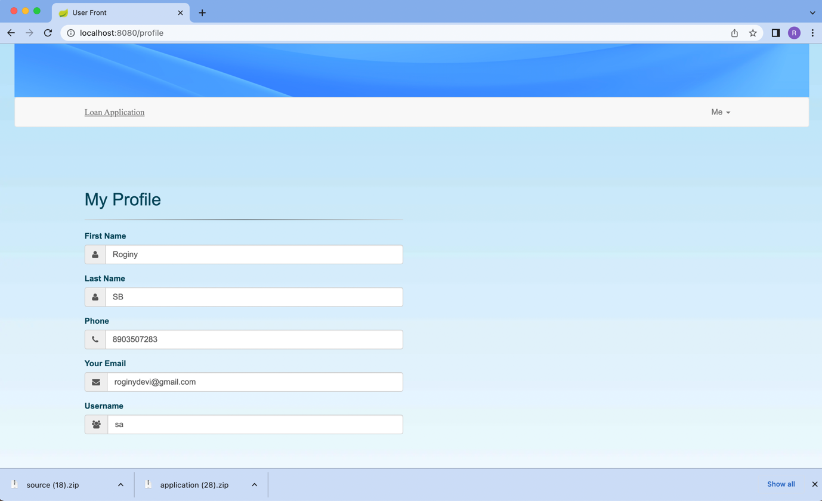
PFMS DALL BANKING – Application Demo
Profile view of the operators and involved developers in the build exercise

Slide 14
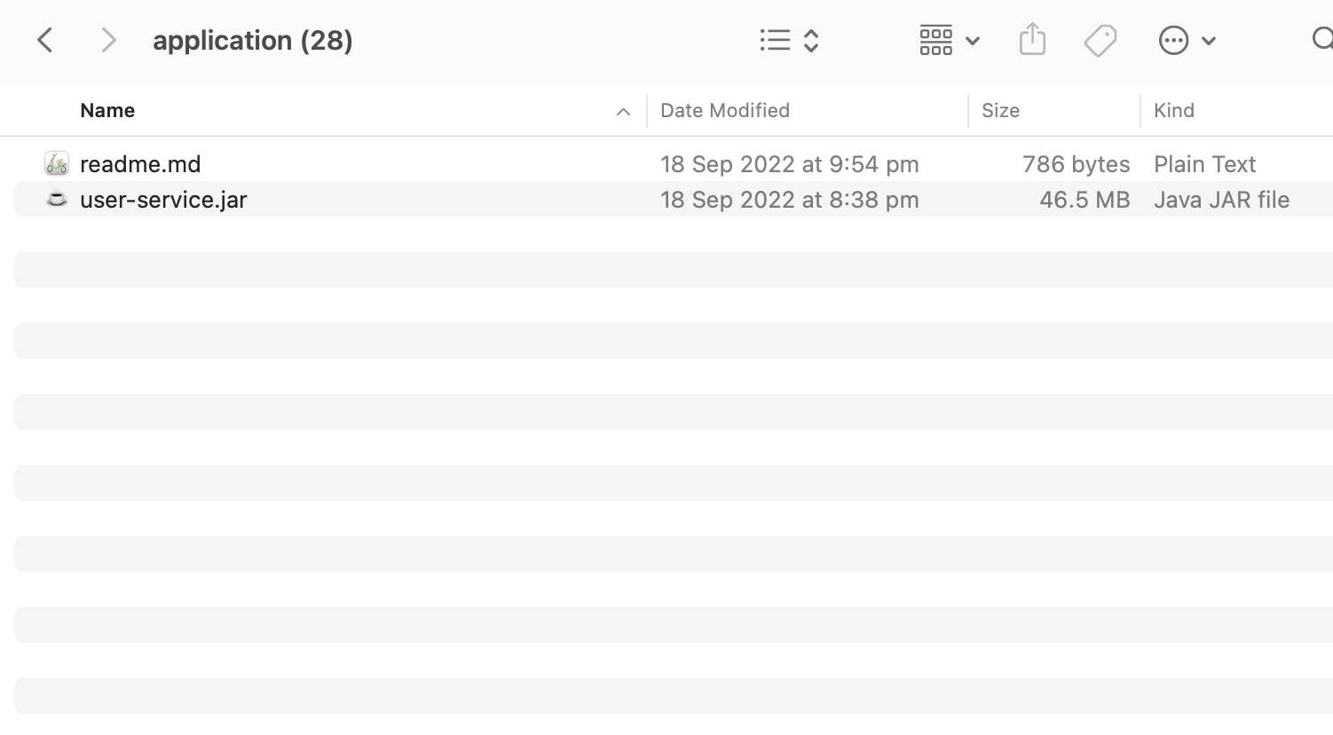
PFMS DALL BANKING – Application Demo
Export view of the application generated

Slide 15
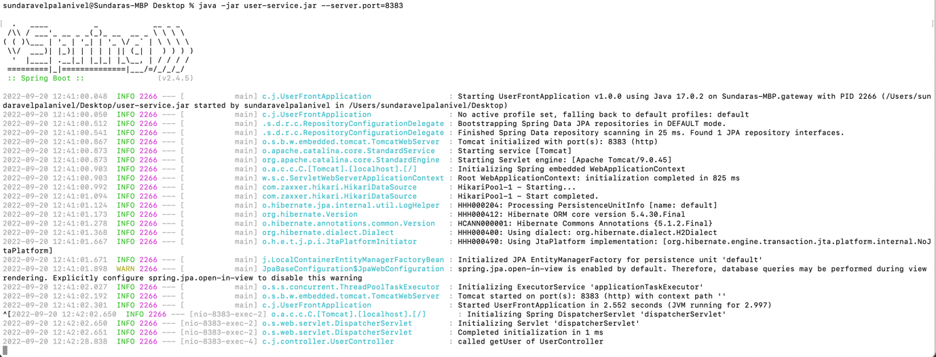
PFMS DALL BANKING – Application Demo
Compilation of the service export

Slide 16
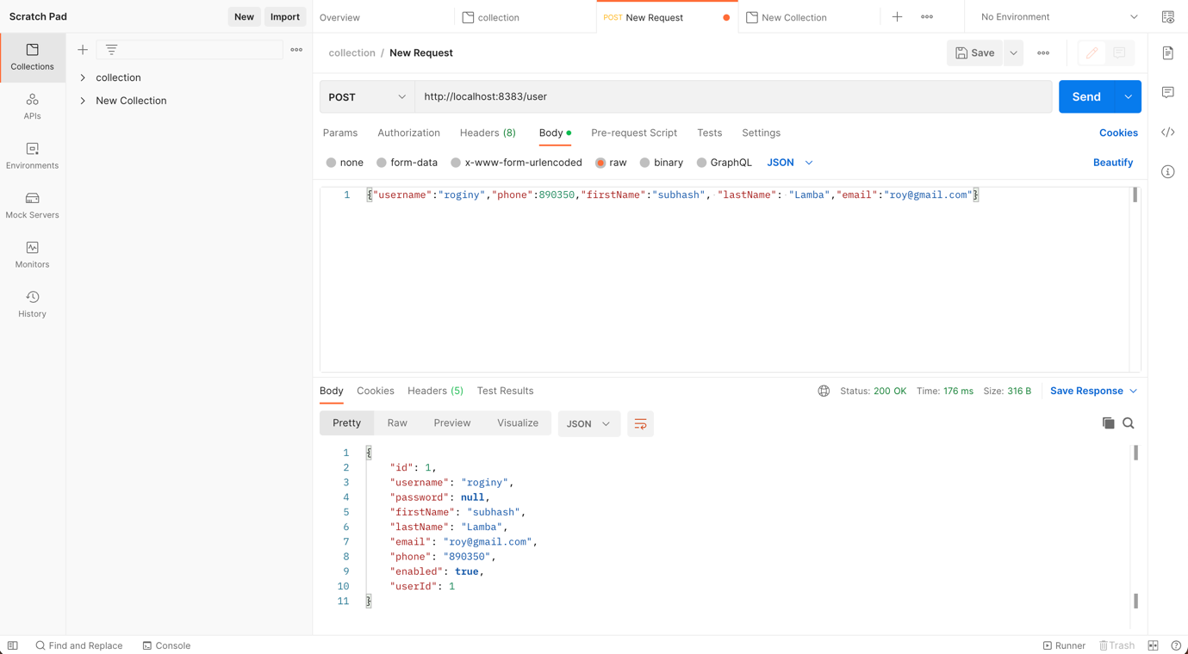
PFMS DALL BANKING – Application Demo
Testing the service via postman

Slide 17
Thank you

